Slide 1
My Perimeter, Area and Volume Interactive Notebook
Name
Class
Term 3 Semester 2

Slide 2
Contents
Formula Page
Page
Date
Description
2
3

Slide 3
Tasks
24
7
30
Essential Question
Questions
Notes
Summary
20
21

Slide 4
24
7
30
Date
Triangular Prisms
EQ – How is a net of a 3-D shape used to find the surface area of a triangular prism?
A net is a 2-D picture that folds to make a 3-D shape.
21

Slide 5
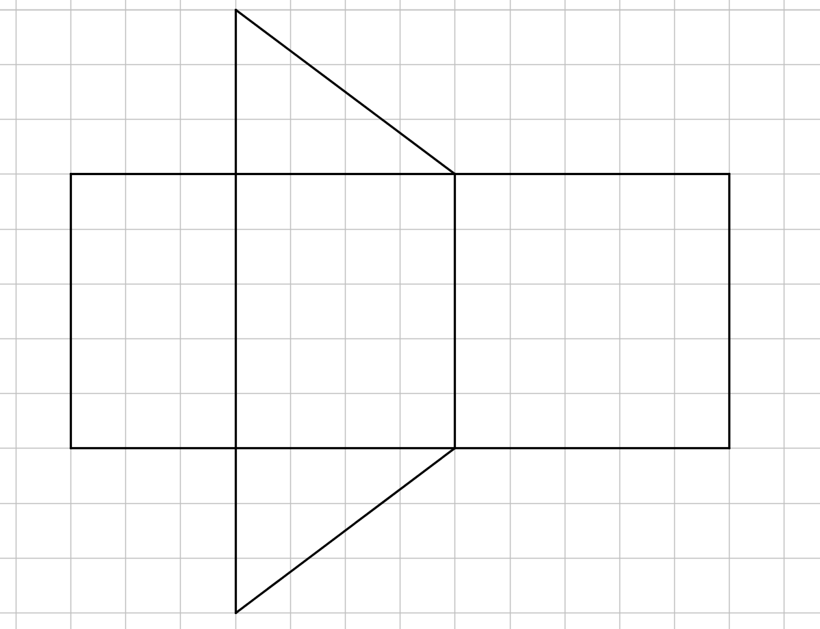
Working -
Area of each face =
Vertices
Name
Total Surface
Area (TSA)=
Faces
Sketch
Volume =
Total Surface Area =
Edges
Volume =
Cut out the net and fill in the information. above

Slide 6
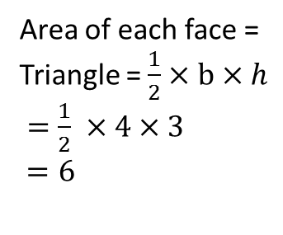
Working -
1
Area of each face =
Triangle = $\frac{1}{2}×b×h$
$=\frac{1}{2} ×4×3$
$=6$
Vertices
3
Name
4
Total Surface
Area (TSA)=
5
Faces
Sketch
Volume =
Total Surface Area =
Edges
2
Volume =
Cut out the net and fill in the information. above

Slide 7
Working -
1
Area of each face =
Triangle = $\frac{1}{2}×b×h$
$=\frac{1}{2} ×4×3$
$=6$
Vertices
3
Name
4
Total Surface
Area (TSA)=
5
Faces
Sketch
Rectangle 3 = 5 x 3 = 15
Volume =
Total Surface Area =
Edges
2
Volume =
Cut out the net and fill in the information. above

Slide 8
Working -
1
Area of each face =
Triangle = $\frac{1}{2}×b×h$
$=\frac{1}{2} ×4×3$
$=6$
Vertices
3
Name
4
Total Surface
Area (TSA)=
5
Faces
Sketch
Rectangle 3 = 5 x 3 = 15
Volume =
Rectangle 4 = 5 x 4 = 20
Total Surface Area =
Edges
2
Volume =
Cut out the net and fill in the information. above

Slide 9
Working -
1
Area of each face =
Triangle = $\frac{1}{2}×b×h$
$=\frac{1}{2} ×4×3$
$=6$
Vertices
3
Name
4
Total Surface
Area (TSA)=
5
Faces
Sketch
Rectangle 3 = 5 x 3 = 15
Volume =
Rectangle 4 = 5 x 4 = 20
Rectangle 5 = 5 x 5 = 25
Total Surface Area =
Edges
2
Volume =
Cut out the net and fill in the information. above

Slide 10
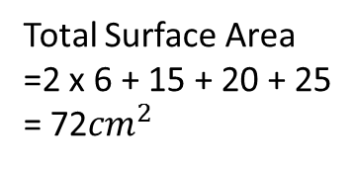
Working -
1
Area of each face =
Triangle = $\frac{1}{2}×b×h$
$=\frac{1}{2} ×4×3$
$=6$
Vertices
3
Name
4
Total Surface
Area (TSA)=
5
Faces
Sketch
Rectangle 3 = 5 x 3 = 15
Volume =
Rectangle 4 = 5 x 4 = 20
Rectangle 5 = 5 x 5 = 25
Total Surface Area
=2 x 6 + 15 + 20 + 25
= 72${cm}^{2}$
Edges
2
Volume =
Cut out the net and fill in the information. above

Slide 11
Working -
1
Area of each face =
Triangle = $\frac{1}{2}×b×h$
$=\frac{1}{2} ×4×3$
$=6$
Vertices
3
Name
4
Total Surface
Area (TSA)=
5
Faces
Sketch
Rectangle 3 = 5 x 3 = 15
Volume =
Rectangle 4 = 5 x 4 = 20
Rectangle 5 = 5 x 5 = 25
Total Surface Area
=2 x 6 + 15 + 20 + 25
= 72${cm}^{2}$
Edges
2
Volume
= area of triangle x length
Cut out the net and fill in the information. above

Slide 12
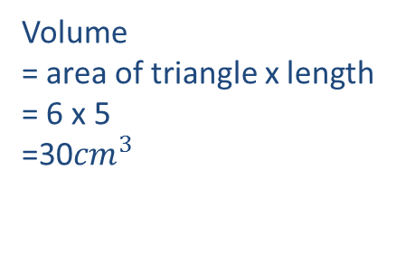
Working -
1
Area of each face =
Triangle = $\frac{1}{2}×b×h$
$=\frac{1}{2} ×4×3$
$=6$
Vertices
3
Name
4
Total Surface
Area (TSA)=
5
Faces
Sketch
Rectangle 3 = 5 x 3 = 15
Volume =
Rectangle 4 = 5 x 4 = 20
Rectangle 5 = 5 x 5 = 25
Total Surface Area
=2 x 6 + 15 + 20 + 25
= 72${cm}^{2}$
Edges
2
Volume
= area of triangle x length
= 6 x 5
=30${cm}^{3}$
Cut out the net and fill in the information. above

Slide 13
24
7
30
Date
Triangular Prisms
EQ – How is a net of a 3-D shape used to find the surface area of a triangular prism?
TSA = Sum the area of all the faces
Volume = Area of triangle x Length
21

Slide 14
24
7
30
Date
Triangular Prisms
EQ – How is a net of a 3-D shape used to find the surface area of a triangular prism?
TSA = Sum the area of all the faces
Volume = Area of triangle x Length
21

Slide 15
Questions

Slide 16
24
7
30
Date
Triangular Prisms
EQ – How is a net of a 3-D shape used to find the surface area of a triangular prism?
How do I find the Surface area and volume of a triangulat prism?
TSA = Sum the area of all the faces
Volume = Area of triangle x Length
21

Slide 17
Notes Review
24, 7 ,30
Date
Title
Essential question
Notes complete
Notes complete with colour and diagrams
Questions completed
Contents page filed in
Formula page filled in

Slide 18
Homework
Review your notes and write a summary answering the essential question.

Slide 19
Plenary
Draw three shapes with a perimeter of 36cm.

